Slide 1
Bluemix PaaS and Cloud Foundry Infrastructure
IBM Cloud Ecosystem Development team

Slide 2
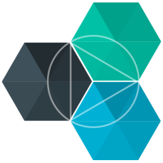
Key Infrastructure components of IBM Bluemix PaaS and
Cloud Foundry
IBM Bluemix
Notes:
IBM Bluemix PaaS built on Cloud Foundry. It’s important to understand Bluemix/Cloud Foundry internal architecture, components such as Droplet execution agent (DEA), Cloud Controller, the Router and interaction between DEA and Health Manager in a Cloud Foundry PaaS environment

Slide 3
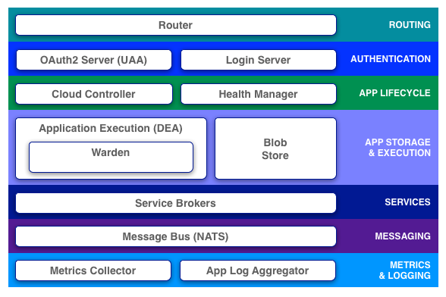
Cloud Foundry Architecture
Notes:
The slide shows Cloud Foundry architecture and components from operations perspective. We will describe the functions of each component in next slides.
Router
The router routes incoming traffic to the appropriate component, usually the Cloud Controller or a running application on a DEA node.
Authentication
The OAuth2 server (the UAA) and Login Server work together to provide identity management.
Cloud Controller
The Cloud Controller is responsible for managing the lifecycle of applications. When a developer pushes an application to Cloud Foundry, the Cloud Controller stores the raw application bits, creates a record to track the application metadata, and directs a DEA node to stage and run the application. The Cloud Controller also maintains records of organizations, spaces, services, service instances, user roles, and more.
Health Manager
Health Manager monitors applications, reconciles the current state (e.g. running, stopped, crashed) and expected state, and directs Cloud Controller to correct state mismatches.
Application Execution (DEA)
The Droplet Execution Agent manages application instances, tracks started instances, and broadcasts state messages.
Application instances live inside Warden containers. Warden manages isolated, ephemeral, and resource-controlled environments.
Containerization ensures that application instances run in isolation, get their fair share of resources, and are protected from noisy neighbors.
Blob Store
The blob store holds:
Application code
Buildpacks
Droplets
Service Brokers
Applications typically depend on services such as databases or third-party SaaS providers. When a developer provisions and binds a service to an application, the service broker for that service is responsible for providing the service instance.
Message Bus
Cloud Foundry uses NATS, a lightweight publish-subscribe and distributed queueing messaging system written in Ruby, for internal communication between components.
Logging and Statistics
The metrics collector gather metrics from the components. Operators can use this information to monitor an instance of Cloud Foundry.
The application log aggregator streams application logs to developers.

Slide 4
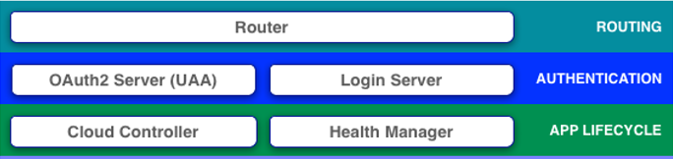
Key Components for Routing, Authentication and App Lifecycle
Routing - Router routes incoming traffic to the appropriate component, usually the Cloud Controller or a running application on a DEA node.
Authentication - The OAuth2 server (the UAA) and Login Server work together to provide identity management.
App Lifecycle – Cloud Controller is responsible for managing the lifecycle of applications. When a developer pushes an application to Cloud Foundry, the Cloud Controller stores the raw application bits, creates a record to track the application metadata, and directs a DEA node to stage and run the application. The Cloud Controller also maintains records of organizations, spaces, services, service instances, user roles, and more. Health Manager monitors applications, reconciles the current state (e.g. running, stopped, crashed) and expected state, and directs Cloud Controller to correct state mismatches
Notes:
For Routing:
The router routes incoming traffic to the appropriate component, usually the Cloud Controller or a running application on a DEA node.
For Authentication
The OAuth2 server (the UAA) and Login Server work together to provide identity management.
For application Lifecycle operations
The Cloud Controller is responsible for managing the lifecycle of applications. When a developer pushes an application to Cloud Foundry, the Cloud Controller stores the raw application bits, creates a record to track the application metadata, and directs a DEA node to stage and run the application. The Cloud Controller also maintains records of organizations, spaces, services, service instances, user roles, and more.
Health Manager monitors applications, reconciles the current state (e.g. running, stopped, crashed) and expected state, and directs Cloud Controller to correct state mismatches.

Slide 5
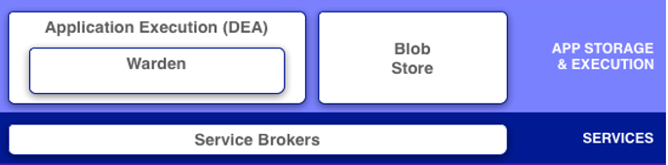
Key Components for Application Execution & Storage and Services
Application Execution
The Droplet Execution Agent (DEA) manages application instances, tracks started instances, and broadcasts state messages. Application instances live inside Warden containers.
Warden manages isolated, ephemeral, and resource-controlled environments. Containerization ensures that application instances run in isolation, get their fair share of resources, and are protected from noisy neighbors.
Application Storage
The Blob Store holds Application code, Buildpacks and Droplets.
Services
Applications typically depend on services such as databases or third-party SaaS providers. When a developer provisions and binds a service to an application, the service broker for that service is responsible for providing the service instance.
Notes:
For application execution
The Droplet Execution Agent (DEA)manages application instances, tracks started instances, and broadcasts state messages.
Application instances live inside Warden containers. Warden manages isolated, ephemeral, and resource-controlled environments.
Containerization ensures that application instances run in isolation, get their fair share of resources, and are protected from noisy neighbors.
For application storage - The blob store holds Application code, Buildpacks, Droplets required for process the application deployment.
Applications typically depend on services such as databases or third-party SaaS providers. When a developer provisions and binds a service to an application, the service broker for that service is responsible for providing the service instance.

Slide 6
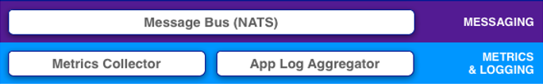
Key Components for Messaging, Metrics & Logging
Messaging
Cloud Foundry uses Message Bus NATS, a lightweight publish-subscribe and distributed queueing messaging system written in Ruby, for internal communication between components.
Metrics and Logging
The metrics collector gathers metrics from the components. Operators can use this information to monitor an instance of Cloud Foundry.
The application log aggregator streams application logs to developers.
Notes:
The key components for Messaging is Message Bus. Cloud Foundry uses NATS, a lightweight publish-subscribe and distributed queueing messaging system written in Ruby, for internal communication between components.
For Logging and Statistics, the metrics collector gather metrics from the components. Operators can use this information to monitor an instance of Cloud Foundry.
The application log aggregator streams application logs to developers.

